Slide 1
NOISE MAPPING THROUGH MOBILE APP IN LIVING ENVIRONMENTS

Slide 2
INTRODUCTION
ENVIRONMENT NOISE AND HEALTH
MATERIALS AND METHODS
DISCUSSION AND RESULTS
CONCLUSION

Slide 3
INTRODUCTION
The ‘environmental noise’ can be seen as an unwanted sound produced by human activities that are considered harmful or detrimental to human health and quality of life.
The concept of the “smart city” has recently been introduced as a strategic device to encompass modern urban production factors in a common framework and, in particular, to highlight the importance of Information and Communication Technologies (ICTs) in the last 20 years for enhancing the competitive profile of a city .

Slide 4
Noise maps are created with standard methodologies and are based on specific
sources such as road traffic, railway traffic, aircraft and industrial.
Several countries such as Germany and the United Kingdom have produced noise maps in the recent past based on statistics.

Slide 5
ENVIRONMENTAL NOISE AND HEALTH
Environmental noise pollution may be a novel risk factor for pregnancy-related hypertension, particularly more severe variants of preeclampsia.
Pregnancy and childhood exposure to road traffic noise can be associated with a higher risk for childhood overweight has been concluded.

Slide 6
In the same city, we can find highsound levels at some locations when compared with other places of the same town that are quieter.
This is many times related to the city design, especially in cities created a long time ago, not planned and even entirely away from
The current mobility needs of the citizens.

Slide 7
MATERIALS AND METHODS
PHP is a fast and multi featured scripting language used for web development.
connections. PHP and
MySQL technologies offer productivity, scalability, high performance and portability to develop Web applications.
PHP and MySQL are free development tools with a large community.

Slide 8
PHP applications are supported by the majority of operating systems such as Solaris, UNIX, Windows and PHP is an easy language based on the C programming language and providessignificantly reduced database configuration time.
On the other hand, PHP has a poor quality of handling errors as PHP has a limited amount of debugging tools when compared to other Web development languages.
Therefore, this mobile application use PHP Web Services for data communication and MySQL as a database management system.

Slide 9
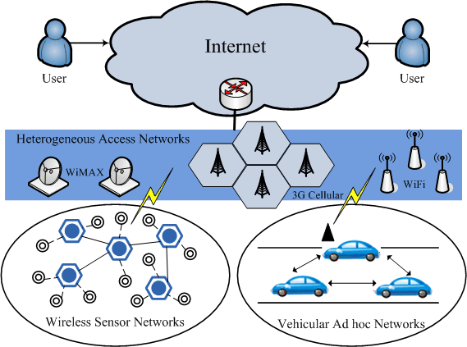

Slide 10
This framework provides methods for capturing, processing, synthesising, controlling, importing and exporting audiovisual media on Apple platforms.
Core Audio is a low-leAVFoundation is native framework developed by Apple for audiovisual vel native Apple framework forsound analysis.
Using Core Location is possible to get the device’s geographic location,altitude, orientation, or position relative to a nearby iBeacon.
The framework uses all available onboard hardware, including Wi-Fi, GPS, Bluetooth, magnetometer,barometer, and cellular hardware to gather data.

Slide 11
DISCUSSION AND RESULTS
The iNoiseMapping provides two major features. In the map view scene, the user can consult the participatory data collected.
The user can check the dBA level of the environment and press the “share” button to contribute with real-time noise data from their environment. Figure 3 shows the iNoiseMapping features.

Slide 12
In order to access the device’s GPS location, GPS access must be requested to theuser.
The iNoiseMapping application can access to the device’s location data only.
when the application is used. To enhanced user privacy, the microphone recording feature must be request and the user must accept before audio recording.
The smartphone application allows quick, simple access, intuitive and real-time

Slide 13
The Internet of Everything (IoE) concept aims to connect people, data, things, and
processes in a global network which used intelligently will provide significant
enhancements on the daily lives of human beings, particularly in the smart city contex
Therefore, this mobile application is a useful and cost-effective tool to collect real-time
environmental sound data.
As future work, the main goal is to make technical improvements, including the development of important alerts and notifications to inform the city authorities when

Slide 14
CONCLUSION
Several studies present in the literature advice for noise reduction as this can be assumed as a significant problem for global health.
The environmental noise pollution can be related to annoyance, sleep and cognitive performance, raised blood pressure and a risk factor for pregnancy-related hypertension.
Noise maps are created with standard methodologies and are based on specific sources such as road traffic, railway traffic.

